Slide 1

Naïve Bayes Classification
By:
Dr. G G Md Nawaz Ali
E-mail: nali@fsmail.bradley.edu
Refs:
https://www.datacamp.com/tutorial/naive-bayes-scikit-learn
https://learn.zybooks.com/zybook/AliMachineAug2023_2/chapter/2/section/3
An Introduction to Statistical learning by Gareth James

Slide 2
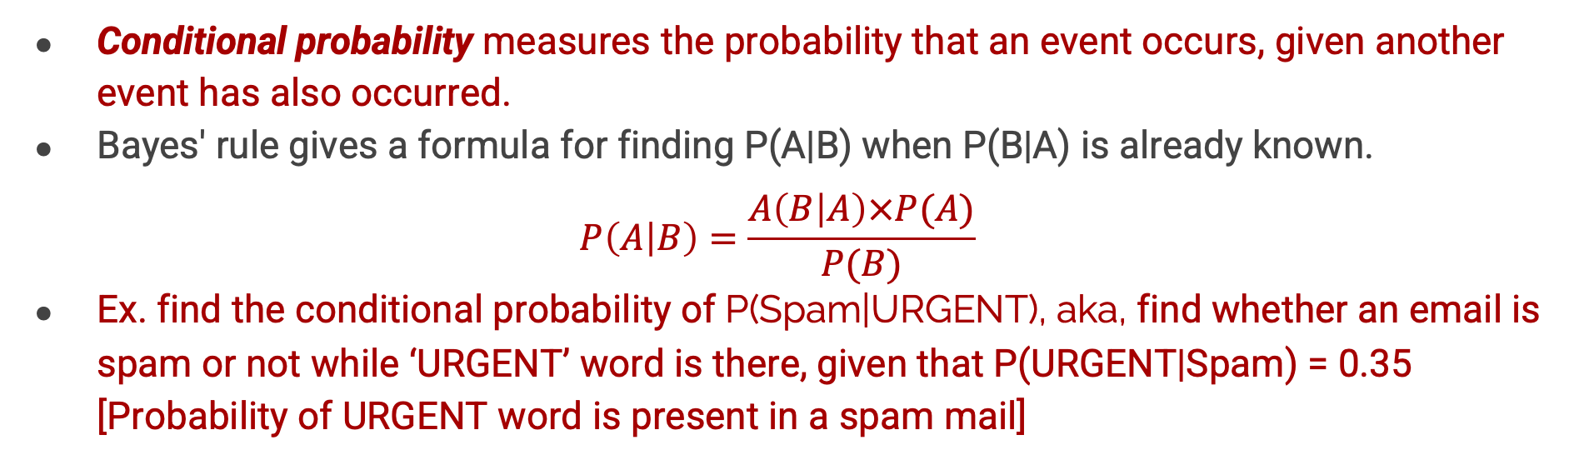
Bayes’ rule
Conditional probability measures the probability that an event occurs, given another event has also occurred.
Bayes' rule gives a formula for finding P(A|B) when P(B|A) is already known.
$$P\left(A | B\right)=\frac{A\left(B | A\right)×P(A)}{P(B)}$$
Ex. find the conditional probability of P(Spam|URGENT), aka, find whether an email is spam or not while ‘URGENT’ word is there, given that P(URGENT|Spam) = 0.35 [Probability of URGENT word is present in a spam mail]

Slide 3
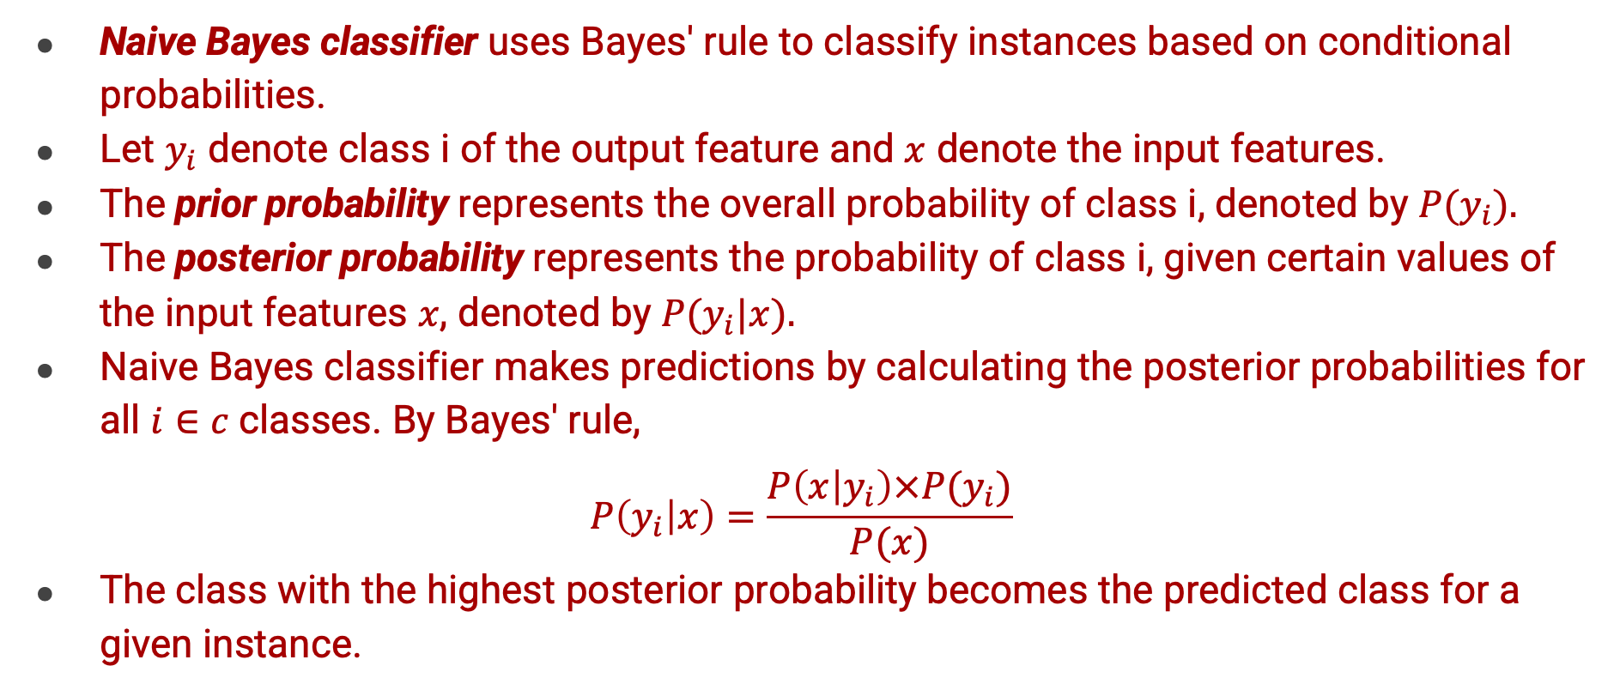
Naïve Bayes Classifier
Naive Bayes classifier uses Bayes' rule to classify instances based on conditional probabilities.
Let $y_{i}$ denote class i of the output feature and $x$ denote the input features.
The prior probability represents the overall probability of class i, denoted by $P(y_{i}).$
The posterior probability represents the probability of class i, given certain values of the input features $x$, denoted by $P(y_{i}|x).$
Naive Bayes classifier makes predictions by calculating the posterior probabilities for all $i∈c$classes. By Bayes' rule,
$$P\left(y_{i} | x\right)=\frac{P\left(x | y_{i}\right)×P(y_{i})}{P(x)}$$
The class with the highest posterior probability becomes the predicted class for a given instance.

Slide 4
Naïve Bayes Classifier
Classifying steps:
Step 1: Calculate the prior probability for given class labels
Step 2: Find Likelihood probability with each attribute for each class
Step 3: Put these value in Bayes Formula and calculate posterior probability.
Step 4: See which class has a higher probability, the input belongs to the higher probability class.

Slide 5
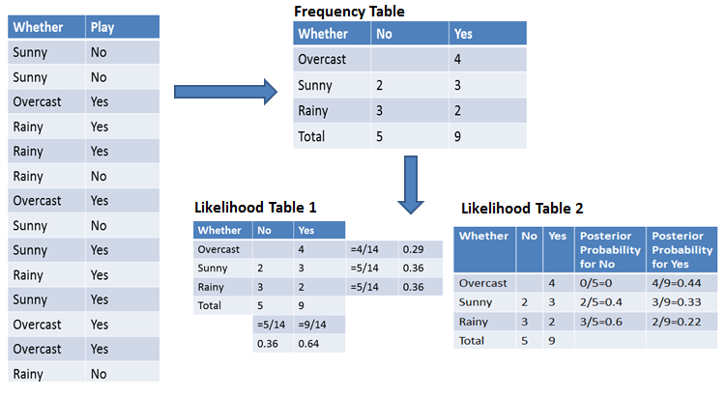
Naive Bayes Classifier Example
Weather
Weather
Weather
Weather
Prior probabilities
Posterior probabilities
Ref: https://www.datacamp.com/tutorial/naive-bayes-scikit-learn

Slide 6
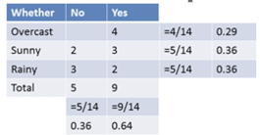
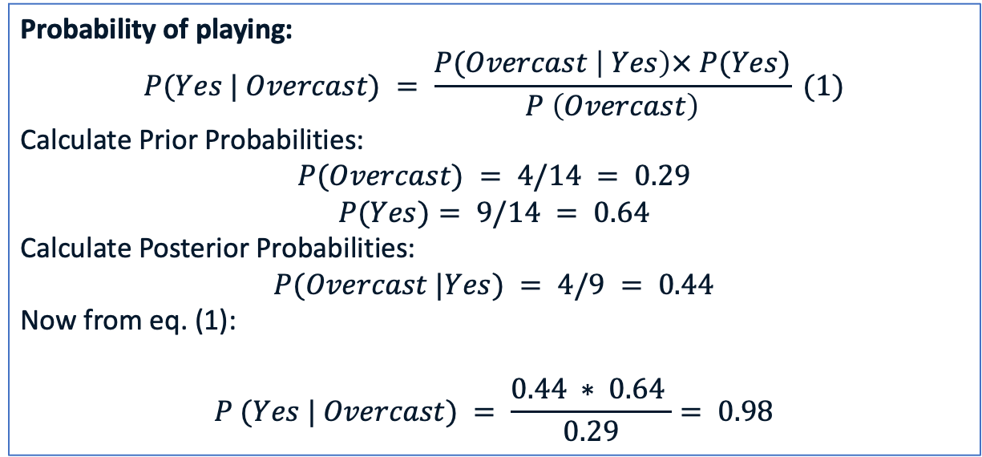
Naive Bayes Classifier Example
Weather
Probability of playing:
$$P(Yes | Overcast) = \frac{P(Overcast \left| Yes\right)× P(Yes)}{P \left(Overcast\right)} (1)$$
Calculate Prior Probabilities:
$$P(Overcast) = 4/14 = 0.29$$
$$P(Yes)= 9/14 = 0.64$$
Calculate Posterior Probabilities:
$P(Overcast |Yes) = 4/9 = 0.44$
Now from eq. (1):
$$P (Yes | Overcast) = \frac{0.44 ∗ 0.64 }{0.29}= 0.98$$
Weather

Slide 7
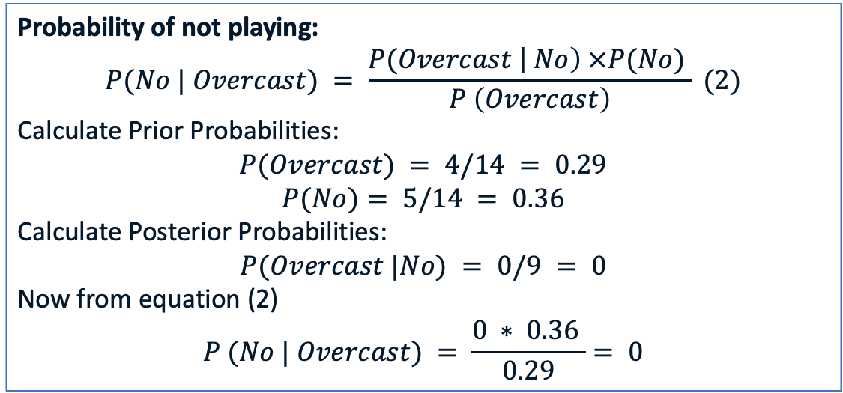
Naive Bayes Classifier Example
Weather
Probability of not playing:
$$P(No | Overcast) = \frac{P(Overcast \left| No\right) ×P(No) }{P \left(Overcast\right)} (2)$$
Calculate Prior Probabilities:
$$P(Overcast) = 4/14 = 0.29$$
$$P(No)= 5/14 = 0.36$$
Calculate Posterior Probabilities:
$$P(Overcast |No) = 0/9 = 0$$
Now from equation (2)
$$P (No | Overcast) = \frac{0 ∗ 0.36 }{0.29}= 0$$
Weather
Ref: https://www.datacamp.com/tutorial/naive-bayes-scikit-learn

Slide 8
Naive Bayes Classifier Example
Since the probability of a 'Yes' class (0.98) is higher than ‘No’ class (0.0). Hence if the weather is overcast than players will play the sport.
Ref: https://www.datacamp.com/tutorial/naive-bayes-scikit-learn

Slide 9
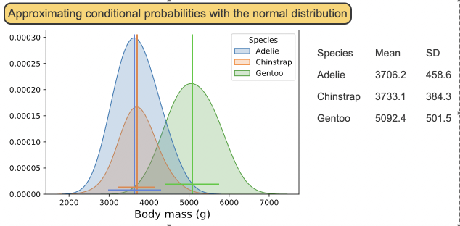
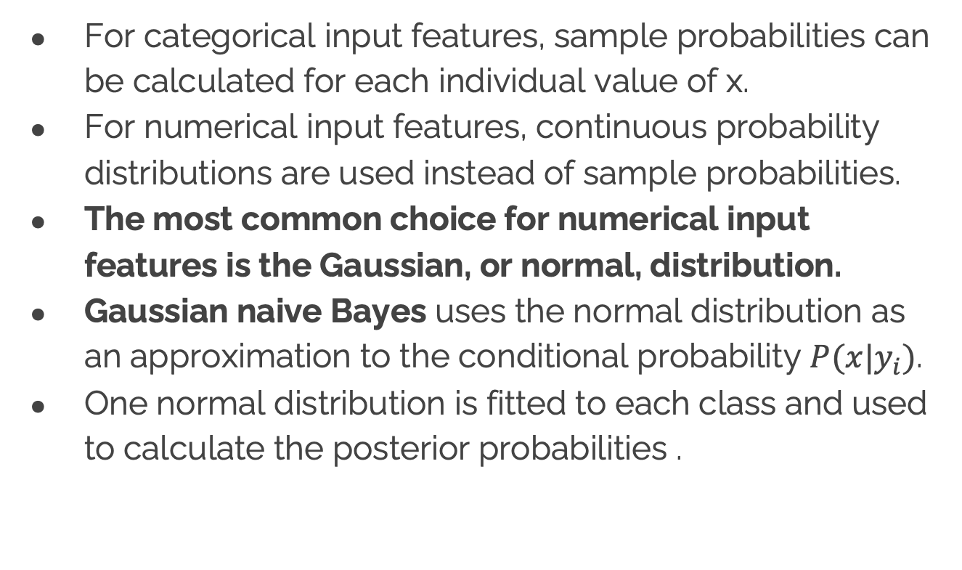
Gaussian Naïve Bayes (for continues valued features)
For categorical input features, sample probabilities can be calculated for each individual value of x.
For numerical input features, continuous probability distributions are used instead of sample probabilities.
The most common choice for numerical input features is the Gaussian, or normal, distribution.
Gaussian naive Bayes uses the normal distribution as an approximation to the conditional probability $P(x|y_{i})$.
One normal distribution is fitted to each class and used to calculate the posterior probabilities .
Each mean and SD will provide normal distribution for that species class
class: species
feature: body mass

Slide 10
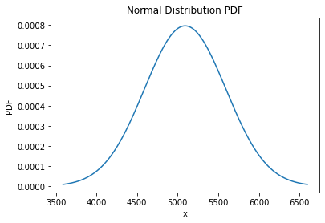
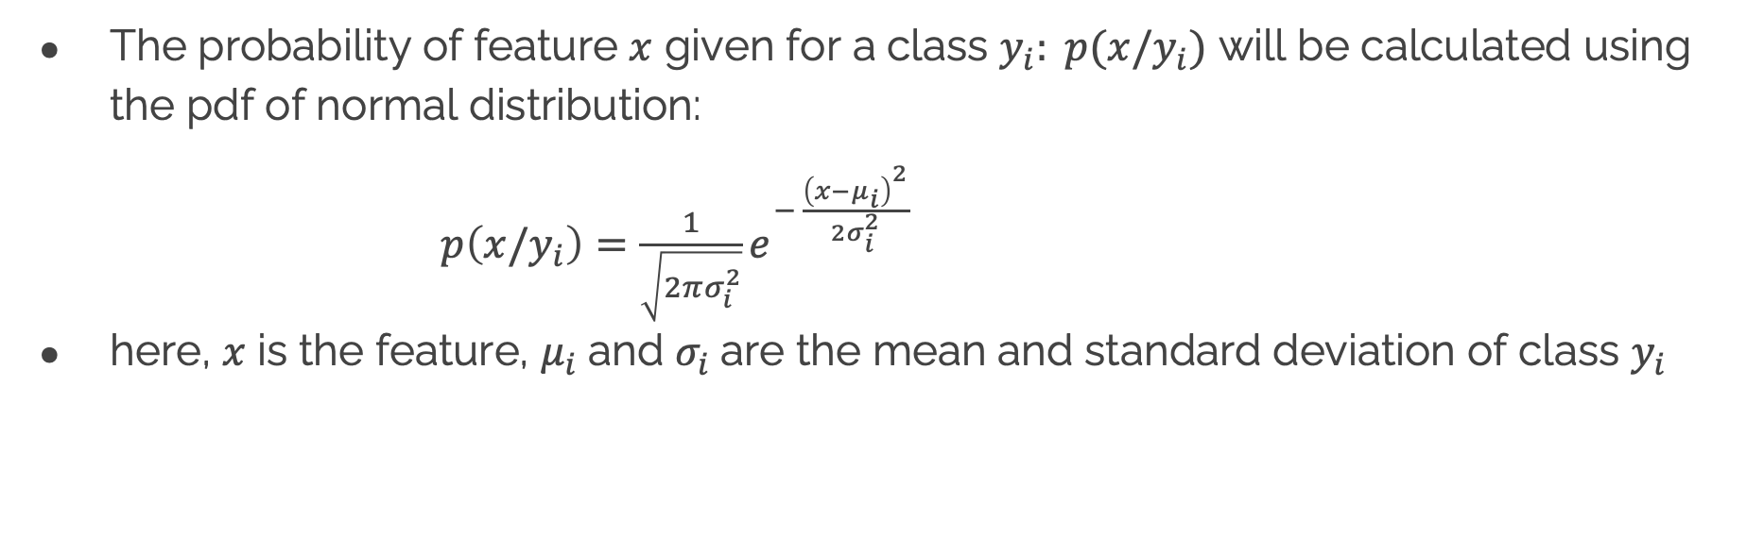
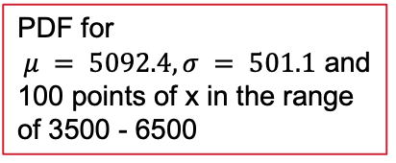
Gaussian Naïve Bayes (for continues valued features)
The probability of feature $x$ given for a class $y_{i}: p(x/y_{i})$ will be calculated using the pdf of normal distribution:
$p\left(x/y_{i}\right)=\frac{1}{\sqrt{2πσ_{i}^{2}}}e^{− \frac{{\left(x−μ_{i}\right)}^{2}}{2σ_{i}^{2}}}$
here, $x$ is the feature, $μ_{i}$and $σ_{i}$are the mean and standard deviation of class $y_{i}$
PDF for
$μ = 5092.4, σ = 501.1$ and
100 points of x in the range of 3500 - 6500

